Slide 1
服装图像识别： Keras搭建与训练模型
项目4
物联网工程学院

Slide 2
项目目标
能力目标
熟练预处理模型
定义序贯模型与函数式模型
选择合适的损失函数以及优化器
使用fit训练模型
熟练评估与预测模型
熟练保存与加载模型
使用tf.data API构建数据集
知识目标
Keras的发展历史及作用
层的作用及定义层的方法
定义模型的方法
序贯模型的定义方法
函数式模型的定义方法
训练数据集输入模型的方法

Slide 3

认识tf.keras
任务1

Slide 4
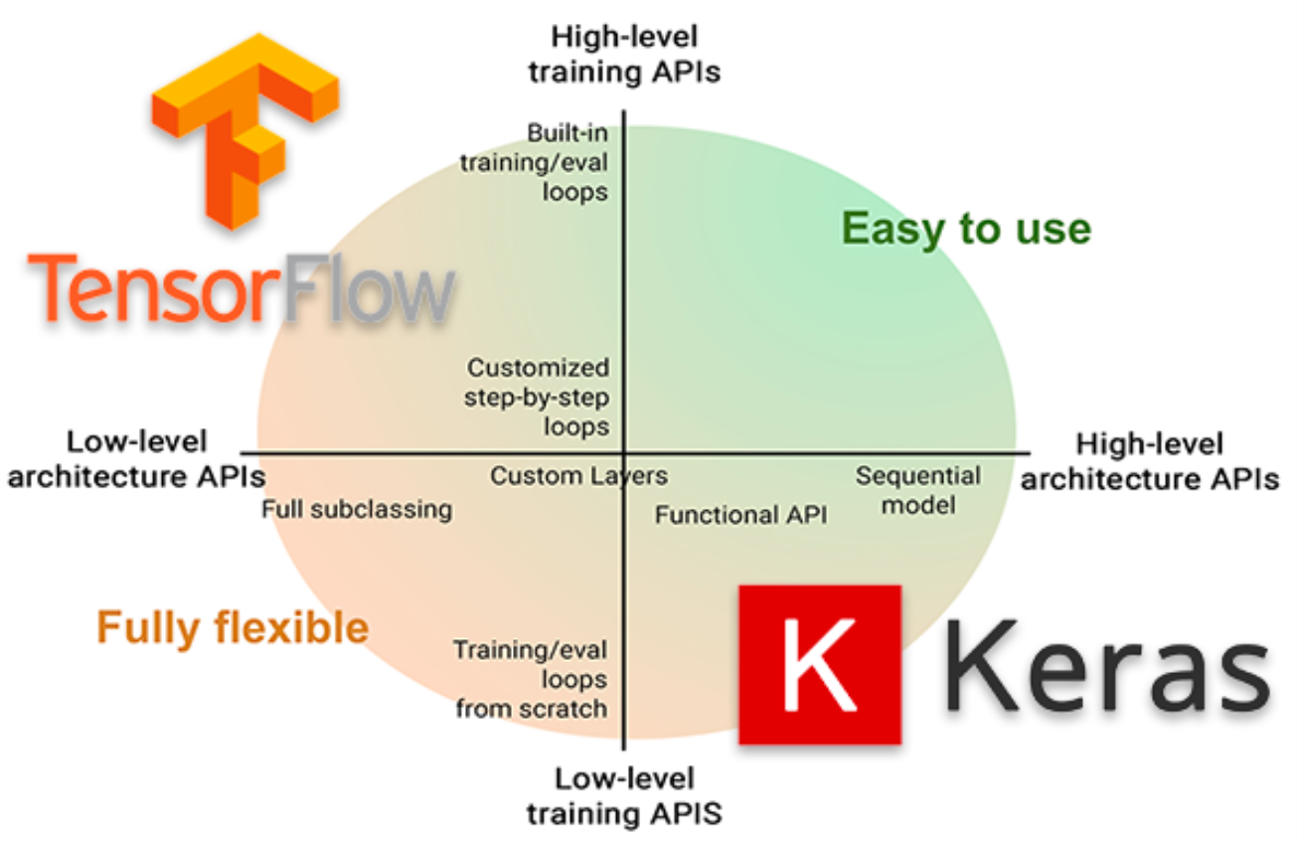
Keras 与tf.keras

Slide 5
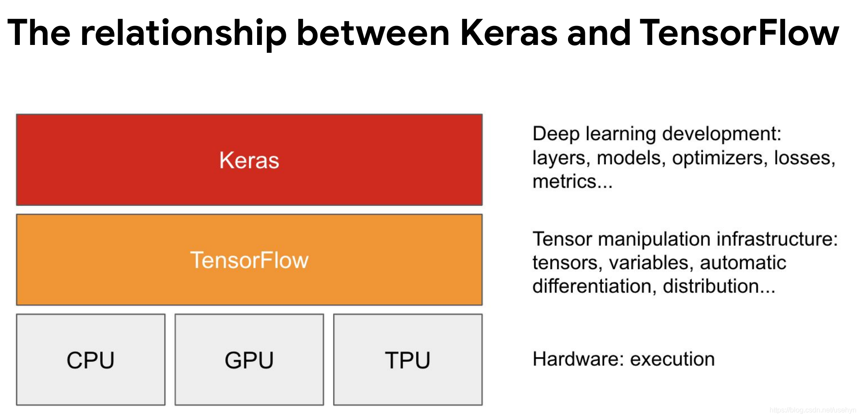
Keras 与tf.keras

Slide 6
Keras 与tf.keras

Slide 7
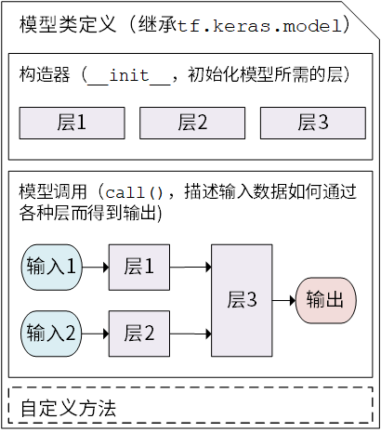
模型（Model）与层（Layer）
层将各种计算流程和变量进行了封装（例如基本的全连接层，CNN 的卷积层、池化层等）
模型将各种层进行组织和连接，并封装成一个整体，描述了如何将输入数据通过各种层以及运算而得到输出。

Slide 8
# 定义层
In[1]:
class Dense(tf.Module):
def __init__(self, in_features, out_features, name=None):
super().__init__(name=name)
self.w = tf.Variable(
tf.random.normal([in_features, out_features]), name='w')
self.b = tf.Variable(tf.zeros([out_features]), name='b')
def __call__(self, x):
y = tf.matmul(x, self.w) + self.b
return tf.nn.relu(y)

Slide 9
# 定义模型
In[2]:
class SequentialModule(tf.Module):
def __init__(self, name=None):
super().__init__(name=name)
self.dense_1 = Dense(in_features=3, out_features=3)
self.dense_2 = Dense(in_features=3, out_features=2)
def __call__(self, x):
x = self.dense_1(x)
return self.dense_2(x)
my_model = SequentialModule(name="the_model")
print("Model results:", my_model(tf.constant([[2.0, 2.0, 2.0]])))

Slide 10
服装图像识别
任务2

Slide 11
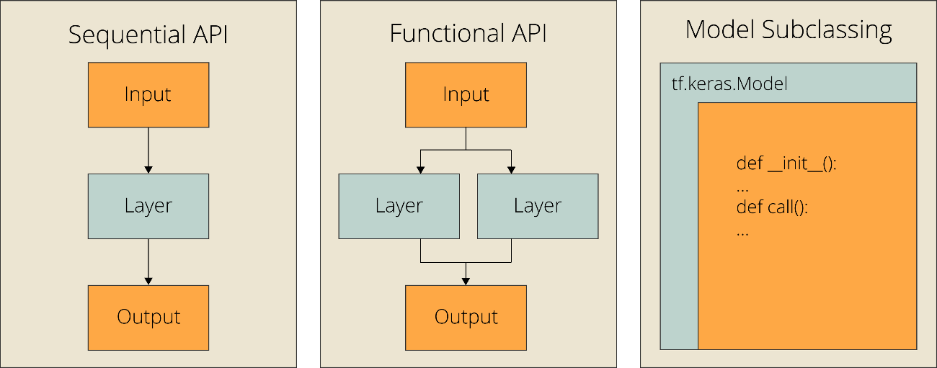
构建模型

Slide 12
# 序贯模型
model = keras.Sequential([
keras.Input(shape=(784)),
layers.Dense(32, activation='relu'),
layers.Dense(32, activation='relu'),
layers.Dense(10),
])
model.summary()
# model.compile(...)
# model.fit(...)
InputLayer(None, 784)
Dense（ None, 32）
Dense（ None, 32）
Dense（ None, 10）

Slide 13
# 序贯模型add() 方法
model = keras.Sequential()
model.add(layers.Dense(64, activation="relu", input_shape=(784,)))
model.add(layers.Dense(64, activation="relu"))
model.add(layers.Dense(10))
model.summary()

Slide 14
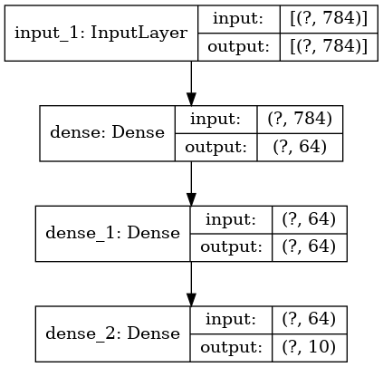
# 函数式
# 这部分返回一个张量
inputs = keras.Input(shape=(784,))
# 层的实例是可调用的，它以张量为参数，并且返回一个张量
x = layers.Dense(64, activation="relu")(inputs)
x = layers.Dense(64, activation="relu")(x)
outputs = layers.Dense(10)(x)
# 这部分创建了一个包含输入层和三个全连接层的模型
model = keras.Model(inputs=inputs, outputs=outputs, name="mnist_model")

Slide 15
# 编译
# For a multi-class classification problem
model.compile(optimizer='rmsprop',
loss='categorical_crossentropy',
metrics=['accuracy'])

Slide 16
model.fit(
x=None,
y=None,
batch_size=None,
epochs=1,
verbose='auto',
callbacks=None,
validation_split=0.0,
validation_data=None,
shuffle=True,
class_weight=None,
sample_weight=None,
initial_epoch=0,
steps_per_epoch=None,
validation_steps=None,
validation_batch_size=None,
validation_freq=1,
max_queue_size=10
)
# 训练

Slide 17
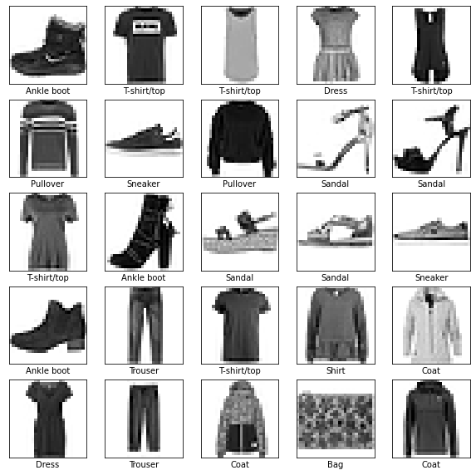
服装图像识别
Step1: 准备数据
Step2: 搭建模型
Step3: 迭代训练
Step4: 使用模型

Slide 18
# 下载数据集
In[1]:
import tensorflow as tf
from tensorflow import keras
import numpy as np
import matplotlib.pyplot as plt
fashion_mnist = keras.datasets.fashion_mnist
(train_images, train_labels), (test_images, test_labels) = fashion_mnist.load_data()
train_images = train_images.reshape(60000, 784).astype("float32")/255.0
test_images = test_images.reshape(10000, 784).astype("float32")/255.0
print("Training set: {}".format(train_images.shape))
print("Testing set: {}".format(test_images.shape))

Slide 19
# 构建模型
In[2]:
model = keras.Sequential([
keras.layers.Flatten(input_shape=(28, 28)),
keras.layers.Dense(128, activation='relu'),
keras.layers.Dense(10)
])

Slide 20
binary_accuracy
categorical_accuracy
sparse_categorical_accuracy
mean_squared_error
SGD
RMSprop
Adam
# 编译模型
In[3]:
accuracy
mse
mae
model.compile(optimizer='adam',
loss=tf.keras.losses.SparseCategoricalCrossentropy(from_logits=True),
metrics=['accuracy'])
#优化器optimizer：http://keras-cn.readthedocs.io/en/latest/other/optimizers/
#损失函数loss：http://keras-cn.readthedocs.io/en/latest/other/objectives/
#模型评估方法metrics：http://keras-cn.readthedocs.io/en/latest/other/metrics/

Slide 21
# 训练模型
In[4]:
history = model.fit(
train_images,
train_labels,
epochs=10,
validation_split=0.2
)
#训练数据的总量=原始样本数量 * epochs
Out[4]:
Epoch 9/10
1875/1875 [==============================] - 4s 2ms/step - loss: 0.2506 - accuracy: 0.9058
Epoch 10/10
1875/1875 [==============================] - 4s 2ms/step - loss: 0.2393 - accuracy: 0.9097
<keras.callbacks.History at 0x7fadef5a1c10>

Slide 22
# 评估模型
In[5]:
test_loss, test_acc = model.evaluate(test_images, test_labels, verbose=2)
print('\nTest accuracy:', test_acc)
Out[5]:
313/313 - 1s - loss: 0.3511 - accuracy: 0.8774 - 675ms/epoch - 2ms/step
Test accuracy: 0.8773999810218811

Slide 23
# 进行预测
In[6]:
test_images = test_images.reshape(10000, 28,28)
probability_model = tf.keras.Sequential([model,
tf.keras.layers.Softmax()])
predictions = probability_model.predict(test_images)
print(predictions[0])
print(np.argmax(predictions[0]))
Out[6]:
array([7.7300720e-06, 3.1858748e-11, 3.0451045e-07, 2.7817364e-09,
1.3059016e-09, 3.1923674e-04, 3.9461247e-06, 1.5980251e-02,
5.8933104e-08, 9.8368847e-01], dtype=float32)
9

Slide 24
模型保存与加载
任务3

Slide 25
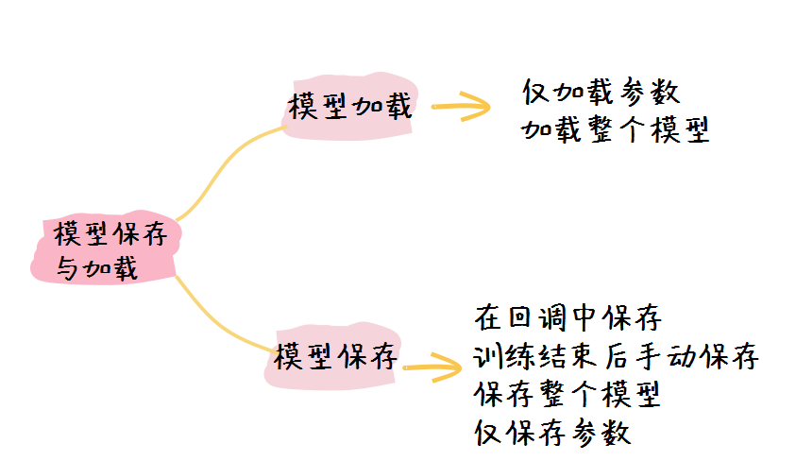
模型保存与加载
架构或配置
模型的状态
编译模型时定义的优化器
损失函数指标
知道模型结构，单纯保存变量。checkpoint， SavedModel
不知道模型结构，保存模型和变量。HDF5
不需要再改变量，只要常量化的模型。Frozen GraphDef，HDF5

Slide 26
# 安装并导入Tensorflow和依赖项
In[1]:
$ pip install pyyaml h5py
import matplotlib.pyplot as plt
import tensorflow as tf
from tensorflow import keras
(train_images, train_labels), (test_images, test_labels) = tf.keras.datasets.mnist.load_data()
train_labels = train_labels[:1000]
test_labels = test_labels[:1000]
train_images = train_images[:1000].reshape(-1, 28 * 28) / 255.0
test_images = test_images[:1000].reshape(-1, 28 * 28) / 255.0

Slide 27
# 定义模型
In[2]:
# Define a simple sequential model
def create_model():
model = tf.keras.models.Sequential([
keras.layers.Dense(512, activation='relu', input_shape=(784,)),
keras.layers.Dropout(0.2),
keras.layers.Dense(10)
])
model.compile(optimizer='adam',
loss=tf.losses.SparseCategoricalCrossentropy(from_logits=True),
metrics=[tf.metrics.SparseCategoricalAccuracy()])
return model
model = create_model()
model.summary()

Slide 28
# 在训练期间保存模型
In[3]:
checkpoint_path = "training_1/cp.ckpt"
checkpoint_dir = os.path.dirname(checkpoint_path)
# Create a callback that saves the model's weights
cp_callback = tf.keras.callbacks.ModelCheckpoint(filepath=checkpoint_path,
save_weights_only=True,
verbose=1)
# Train the model with the new callback
model.fit(train_images,
train_labels,
epochs=10,
validation_data=(test_images, test_labels),
callbacks=[cp_callback]) # Pass callback to training
os.listdir(checkpoint_dir)
['cp.ckpt.data-00000-of-00001', 'cp.ckpt.index', 'checkpoint']

Slide 29
# load_weights加载模型
In[4]:
model = create_model()
# Evaluate the model
loss, acc = model.evaluate(test_images, test_labels, verbose=2)
print("Untrained model, accuracy: {:5.2f}%".format(100 * acc))
# Loads the weights
model.load_weights(checkpoint_path)
# Re-evaluate the model
loss, acc = model.evaluate(test_images, test_labels, verbose=2)
print("Restored model, accuracy: {:5.2f}%".format(100 * acc))
Out[4]:
32/32 - 0s - loss: 0.3860 - sparse_categorical_accuracy: 0.8750 - 75ms/epoch - 2ms/step
Restored model, accuracy: 87.50%

Slide 30
# SavedModel 保存模型
In[5]:
# Create and train a new model instance.
model = create_model()
model.fit(train_images, train_labels, epochs=5)
# Save the entire model as a SavedModel.
!mkdir -p saved_model
model.save('saved_model/my_model')
my_model
assets keras_metadata.pb saved_model.pb variables

Slide 31
# HDF5 格式保存模型
In[6]:
# Create and train a new model instance.
model = create_model()
model.fit(train_images, train_labels, epochs=5)
# Save the entire model to a HDF5 file.
# The '.h5' extension indicates that the model should be saved to HDF5.
model.save('my_model.h5')

Slide 32
tf.data优化训练数据
任务4

Slide 33
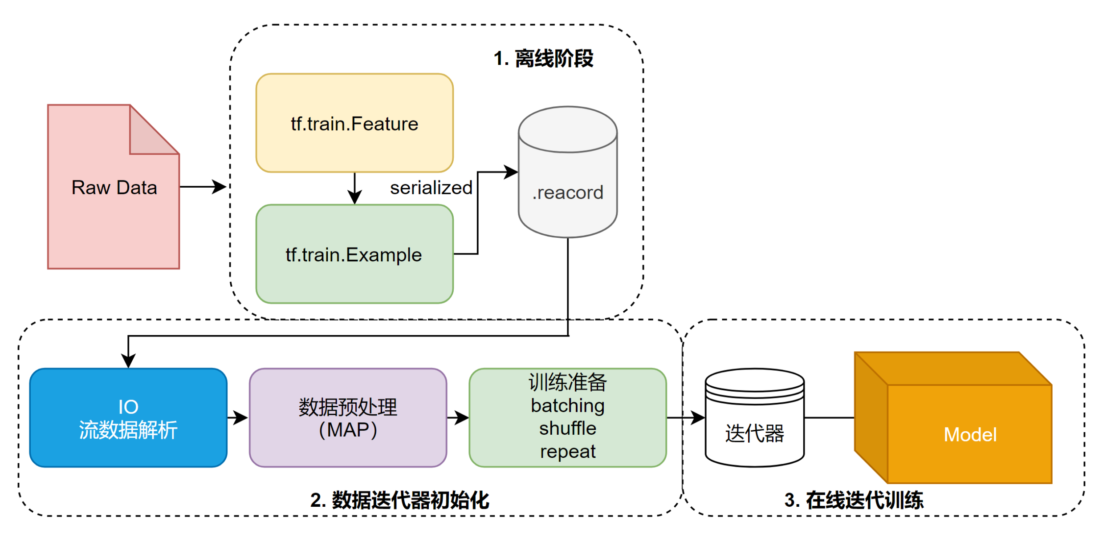
TF Data 数据准备逻辑

Slide 34
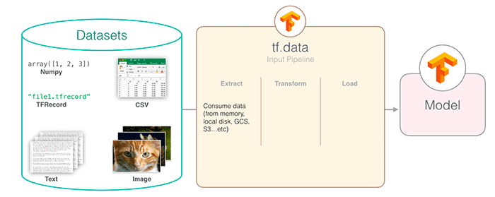
tf.data优点
支持不同的数据源以及数据大小和宽度，如 text、audio、image 和 numpy array
tf.data 采用 ETL 数据处理流程给，即 Extract、Transform 和 Load
将不同类型的数据二进制流存入一个 TFRecord文件中，TFRecord 是一个灵活高效的二进制格式
tf.data 底层实现了比较高效的多线程并行化

Slide 35
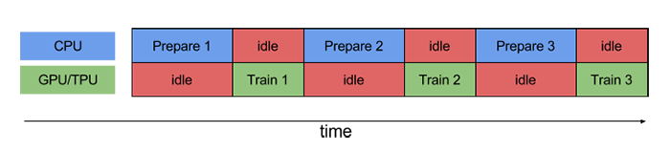
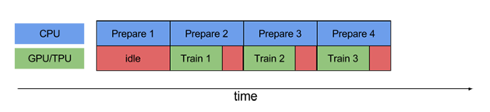
网络结构
随着GPU 和 TPU问世，CPU 处理很容易成为瓶颈
当加速器正在执行训练步骤N时，CPU正在准备步骤N+1的数据

Slide 36
# tf.data.Dataset
In[1]:
(x_train,y_train), (x_test, y_test) = keras.datasets.mnist.load_data()
db_train = tf.data.Dataset.from_tensor_slices((x_train,y_train))
db_train.shuffle(1000)
db_train.map(preprocess)
db_train.batch(64)
db_train.repeat(2)

Slide 37

花卉识别
任务4

Slide 38
# 下载图片
In[1]:
import tensorflow as tf
import pathlib
data_root_orig = tf.keras.utils.get_file(origin='https://storage.googleapis.com/download.tensorflow.org/example_images/flower_photos.tgz',
fname='flower_photos', untar=True)
data_root = pathlib.Path(data_root_orig)
print(data_root)
/.keras/datasets/flower_photos/daisy
/.keras/datasets/flower_photos/dandelion
/.keras/datasets/flower_photos/sunflowers
/.keras/datasets/flower_photos/roses
/.keras/datasets/flower_photos/tulips

Slide 39
# 图片路径
In[2]:
import random
all_image_paths = list(data_root.glob('*/*'))
all_image_paths = [str(path) for path in all_image_paths]
random.shuffle(all_image_paths)
image_count = len(all_image_paths)
print(image_count)
print(all_image_paths[:2])
Out[2]:
3670
['/root/.keras/datasets/flower_photos/dandelion/3451646670_3eff7094b7_n.jpg', '/root/.keras/datasets/flower_photos/dandelion/13887031789_97437f246b.jpg']

Slide 40
# 图片标签
In[3]:
label_names = sorted(item.name for item in data_root.glob('*/') if item.is_dir())
print(label_names)
label_to_index = dict((name, index) for index, name in enumerate(label_names))
print(label_to_index)
all_image_labels = [label_to_index[pathlib.Path(path).parent.name]
for path in all_image_paths]
print("First 10 labels indices: ", all_image_labels[:10])
Out[3]:
['daisy', 'dandelion', 'roses', 'sunflowers', 'tulips']
{'daisy': 0, 'dandelion': 1, 'roses': 2, 'sunflowers': 3, 'tulips': 4}
First 10 labels indices: [4, 2, 3, 3, 0, 1, 1, 0, 1, 1]

Slide 41
# 加载和格式化图片
In[4]:
batch_size = 32
img_height = 180
img_width = 180
def preprocess_image(image):
image = tf.image.decode_jpeg(image, channels=3)
image = tf.image.resize(image, [img_height, img_width
])
image /= 255.0 # normalize to [0,1] range
return image
def load_and_preprocess_image(path):
image = tf.io.read_file(path)
return preprocess_image(image)

Slide 42
# 构建一个 tf.data.Dataset
In[5]:
path_ds = tf.data.Dataset.from_tensor_slices(all_image_paths)
image_ds = path_ds.map(load_and_preprocess_image)
label_ds = tf.data.Dataset.from_tensor_slices(tf.cast(all_image_labels, tf.int64))
image_label_ds = tf.data.Dataset.zip((image_ds, label_ds))
print(image_label_ds)
Out[5]:
<ZipDataset element_spec=(TensorSpec(shape=(192, 192, 3), dtype=tf.float32, name=None), TensorSpec(shape=(), dtype=tf.int64, name=None))>

Slide 43
# 构建数据集
In[6]:
# 设置一个和数据集大小一致的 shuffle buffer size（随机缓冲区大小）以保证数据
# 被充分打乱。
ds = image_label_ds.shuffle(buffer_size=image_count)
ds = ds.repeat()
ds = ds.batch(batch_size)
# 当模型在训练的时候，`prefetch` 使数据集在后台取得 batch。
ds = ds.prefetch(buffer_size=AUTOTUNE)

Slide 44
image_dataset_from_directory

Slide 45
image_dataset_from_directory

Slide 46
# image_dataset_from_directory构建数据集
In[7]:
train_ds = tf.keras.utils.image_dataset_from_directory(
data_root,
validation_split=0.2,
subset="training",
seed=123,
image_size=(img_height, img_width),
batch_size=batch_size)
print(train_ds)
print(train_ds.class_names)
Out[7]:
Found 3670 files belonging to 5 classes. Using 2936 files for training.
<BatchDataset element_spec=(TensorSpec(shape=(None, 180, 180, 3), dtype=tf.float32, name=None), TensorSpec(shape=(None,), dtype=tf.int32, name=None))>
['daisy', 'dandelion', 'roses', 'sunflowers', 'tulips']

Slide 47
# 迁移学习
In[8]:
mobile_net = tf.keras.applications.MobileNetV2(input_shape=(192, 192, 3), include_top=False)
mobile_net.trainable=False
model = tf.keras.Sequential([
mobile_net,
tf.keras.layers.GlobalAveragePooling2D(),
tf.keras.layers.Flatten(),
tf.keras.layers.Dense(128, activation='relu'),
tf.keras.layers.Dense(len(label_names), activation = 'softmax')])
model.compile(optimizer=tf.keras.optimizers.Adam(),
loss='sparse_categorical_crossentropy',
metrics=["accuracy"])
model.summary()

Slide 48
# 训练保存模型
In[9]:
AUTOTUNE = tf.data.AUTOTUNE
train_ds = train_ds.cache().shuffle(1000).prefetch(buffer_size=AUTOTUNE)
normalization_layer = tf.keras.layers.Rescaling(1./255)
normalized_ds = train_ds.map(lambda x, y: (normalization_layer(x), y))
model.fit(train_ds,epochs=10,steps_per_epoch=115)
model.save("mobile_net_flower")
Out[10]:
Epoch 9/10
92/92 [==============================] - 70s 761ms/step - loss: 0.2367 - accuracy: 0.9302
Epoch 10/10
92/92 [==============================] - 72s 774ms/step - loss: 0.2380 - accuracy: 0.9292

Slide 49
# 进行预测
In[10]:
import numpy as np
flower_model = keras.models.load_model("mobile_net_flower")
image_path = '/root/48.jpg'
img = tf.keras.preprocessing.image.load_img(
image_path, target_size=(192, 192)
)
img_array = tf.keras.preprocessing.image.img_to_array(img)
img_array = tf.expand_dims(img_array, 0) # Create a batch
predictions = flower_model.predict(img_array)
score = tf.nn.softmax(predictions[0])
print(
"This image most likely belongs to {} with a {:.2f} percent confidence."
.format(label_names[np.argmax(score)], 100 * np.max(score))
)

